Slide 1
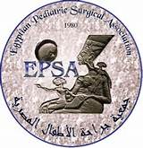
Single prophylactic antibiotic dose versus no prophylaxis in simple clean operative procedures in pediatrics
By
Abdelbaset A.Ahmed Assistant lecturer of pediatric surgery Sohag university, Egypt 2017

Slide 2
Introduction
Different studies underline the use of pre-operative antibiotic prophylaxis in clean surgeries.
Prophylaxis antibiotics is considered optional for most
clean procedures.
Most of the pediatric surgeon use perioperative prophylactic antibiotic in this clean procedure because of fear of infection in their mind.
Nowadays, antimicrobial resistance is on the rise which caused by misusing of antibiotic, so antibiotic resistance can be prevented by stopping misuse of antibiotic and only use antibiotics when needed also Narrow-spectrum antibiotics are preferred over broad-spectrum
antibiotics when possible.
"Review on Antimicrobial Resistance". amr-review.org. Retrieved May 20 , 2016

Slide 3
Aim of the work
The objective of this study is to compare the outcomes of using preoperative single prophylactic antibiotic dose versus no prophylaxis in simple clean operative procedures in pediatrics .

Slide 4
Patients and methods
This study was conducted in the pediatric surgery unit,Sohag University Hospital from January 2017 to august 2017.
One hundred and twenty (120) patients who undergone simple clean procedures such as hernia, Hydrocele ,undescended testis ,tongue tie ,circumcision and lipoma were included in this study.
In all patients subcutaneous layer was closed by single interrupted vicryl (4/0) sutures.
Skin closure was done by continuous subcuticular 4/0 sutures.
Tongue tie was done by bipolar diathermy with no stitching of any case
Exclusion criteria:
patients with immunodeficiency, diabetes, rheumatic heart, and autoimmune diseases were excluded from this study.

Slide 5
Patients and methods
Patients were empirically divided into two groups (Group A and Group B).
The patients of Group A( 45 patients) were given single intravenous dose of ampicillin clavulenic acid in dosage 50-100mg/kg 30 minutes before incision .
The patients of Group B( 75 patients) were not given any perioperative antibiotic.
Surgery in both groups was done under complete aseptic precautions
All patients were discharged with OR dressing with first dressing on 3rd day.
All the patients of both groups were evaluated on 3rd , 6th and 10th postoperative day for examination of wound.

Slide 6
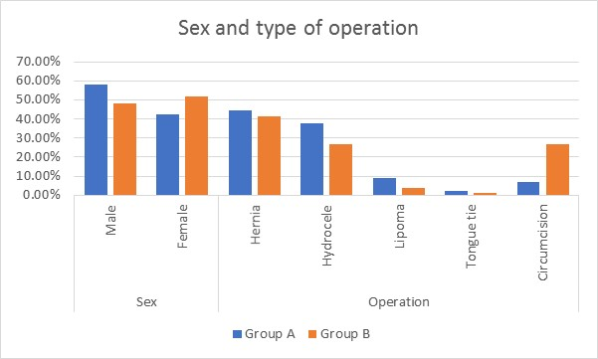

Slide 7
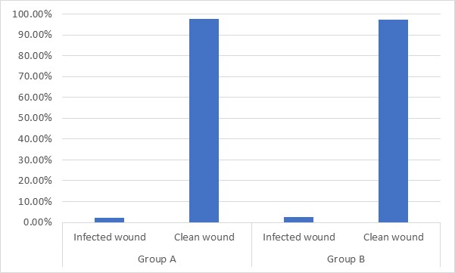
Results
In Group A one patient (2.2%) developed postoperative seroma that appeared on 3rd day with pus discharge appeared on 6th day, drainage was done on 6th day with repeated dressing (twice daily) after culture and sensitivity till complete healing on 12th day.
In Group B two patients (2.66%) developed postoperative wound infection which need repeated dressing and antibiotic coverage according to culture and sensitivity.
There is insignificant difference between the two groups
P value = 0.880 (non significant).

Slide 8
Conclusion
Based on the result of this study, it may be concluded that the antibiotic prophylaxis is not necessary in simple clean surgery in pediatric age group.

Slide 9
Thank you

